Slide 1
WHAT IS NEW WITH INFANT FEEDING AND HIV?
…The BIG news is in the area of breast/chestfeeding
Mona Loutfy, MD, FRCPC, Infectious Diseases, Toronto
Access Place, Prince Albert, Saskatchewan
CANADA

Slide 2
Land Acknowledgement
The WCHC Hub is a virtual network composed of many individual sub-hubs, communities, and organizations spanning the vastness of Turtle Island in the land now known as Canada. We acknowledge our presence on the traditional territories of many Indigenous Nations, and we work to prioritize Indigenous women and gender diverse peoples’ voices, leadership, and direction in our work. We recognize our shared responsibility to work in allyship towards reconciliation with the original stewards of these lands and are committed to fostering meaningful relationships with the communities with which we share this space.
We also want to acknowledge the painful history of slavery here in Canada and its contribution to the lingering effects of medical racism, as well as celebrate the strength and determination of Black communities, who fought – and continue to fight – for freedom, justice, and equality.

Slide 3
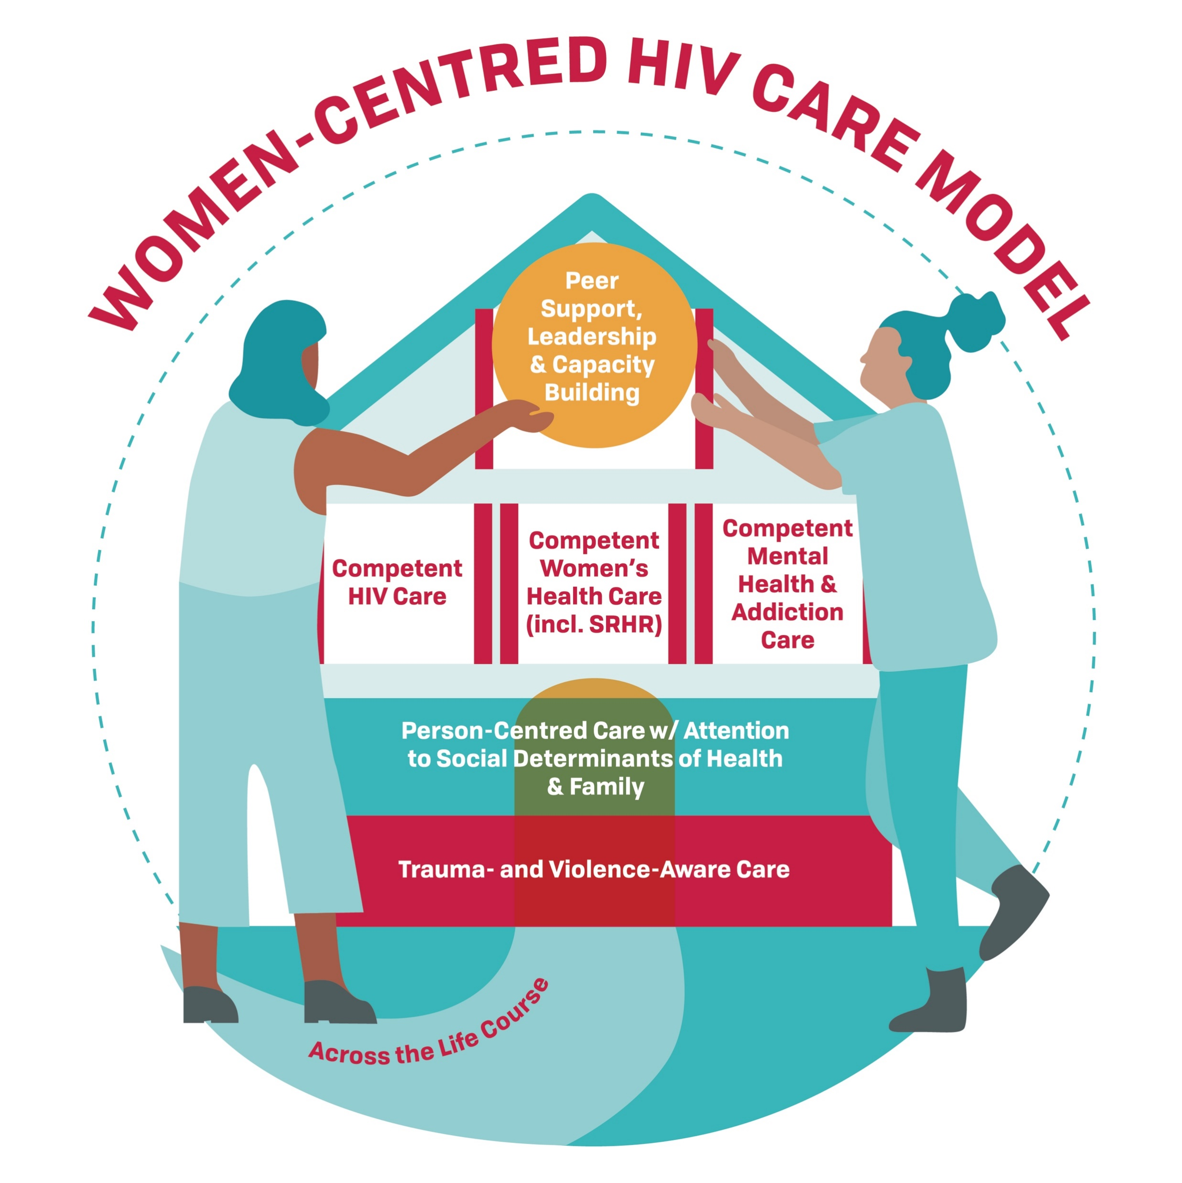
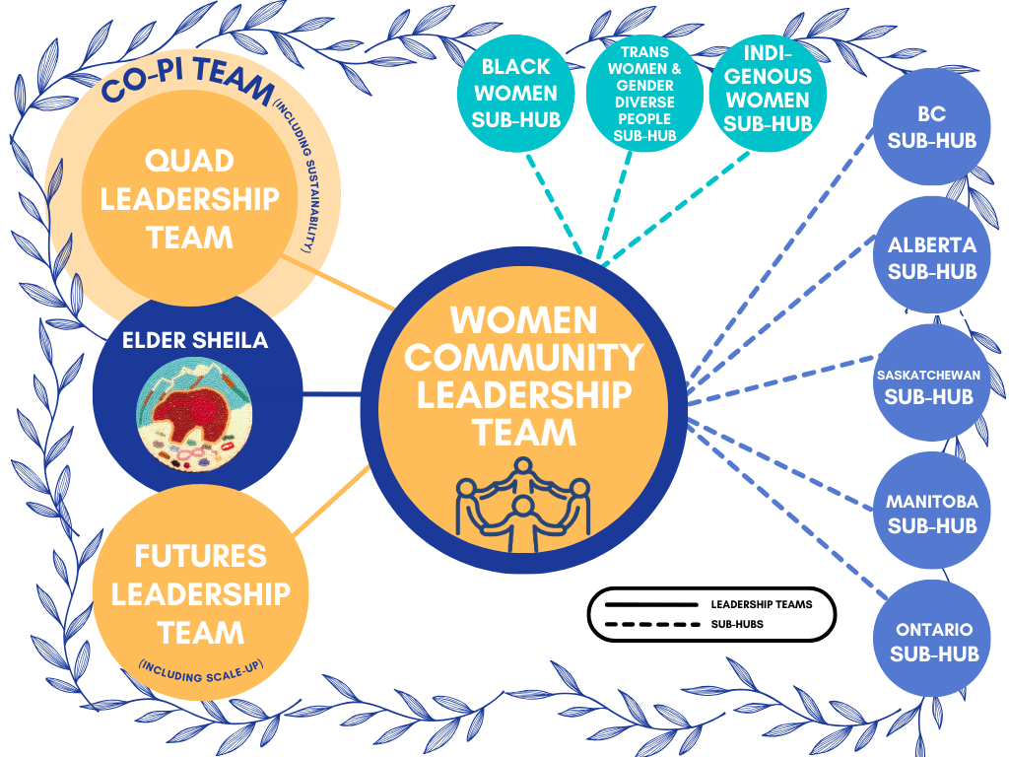
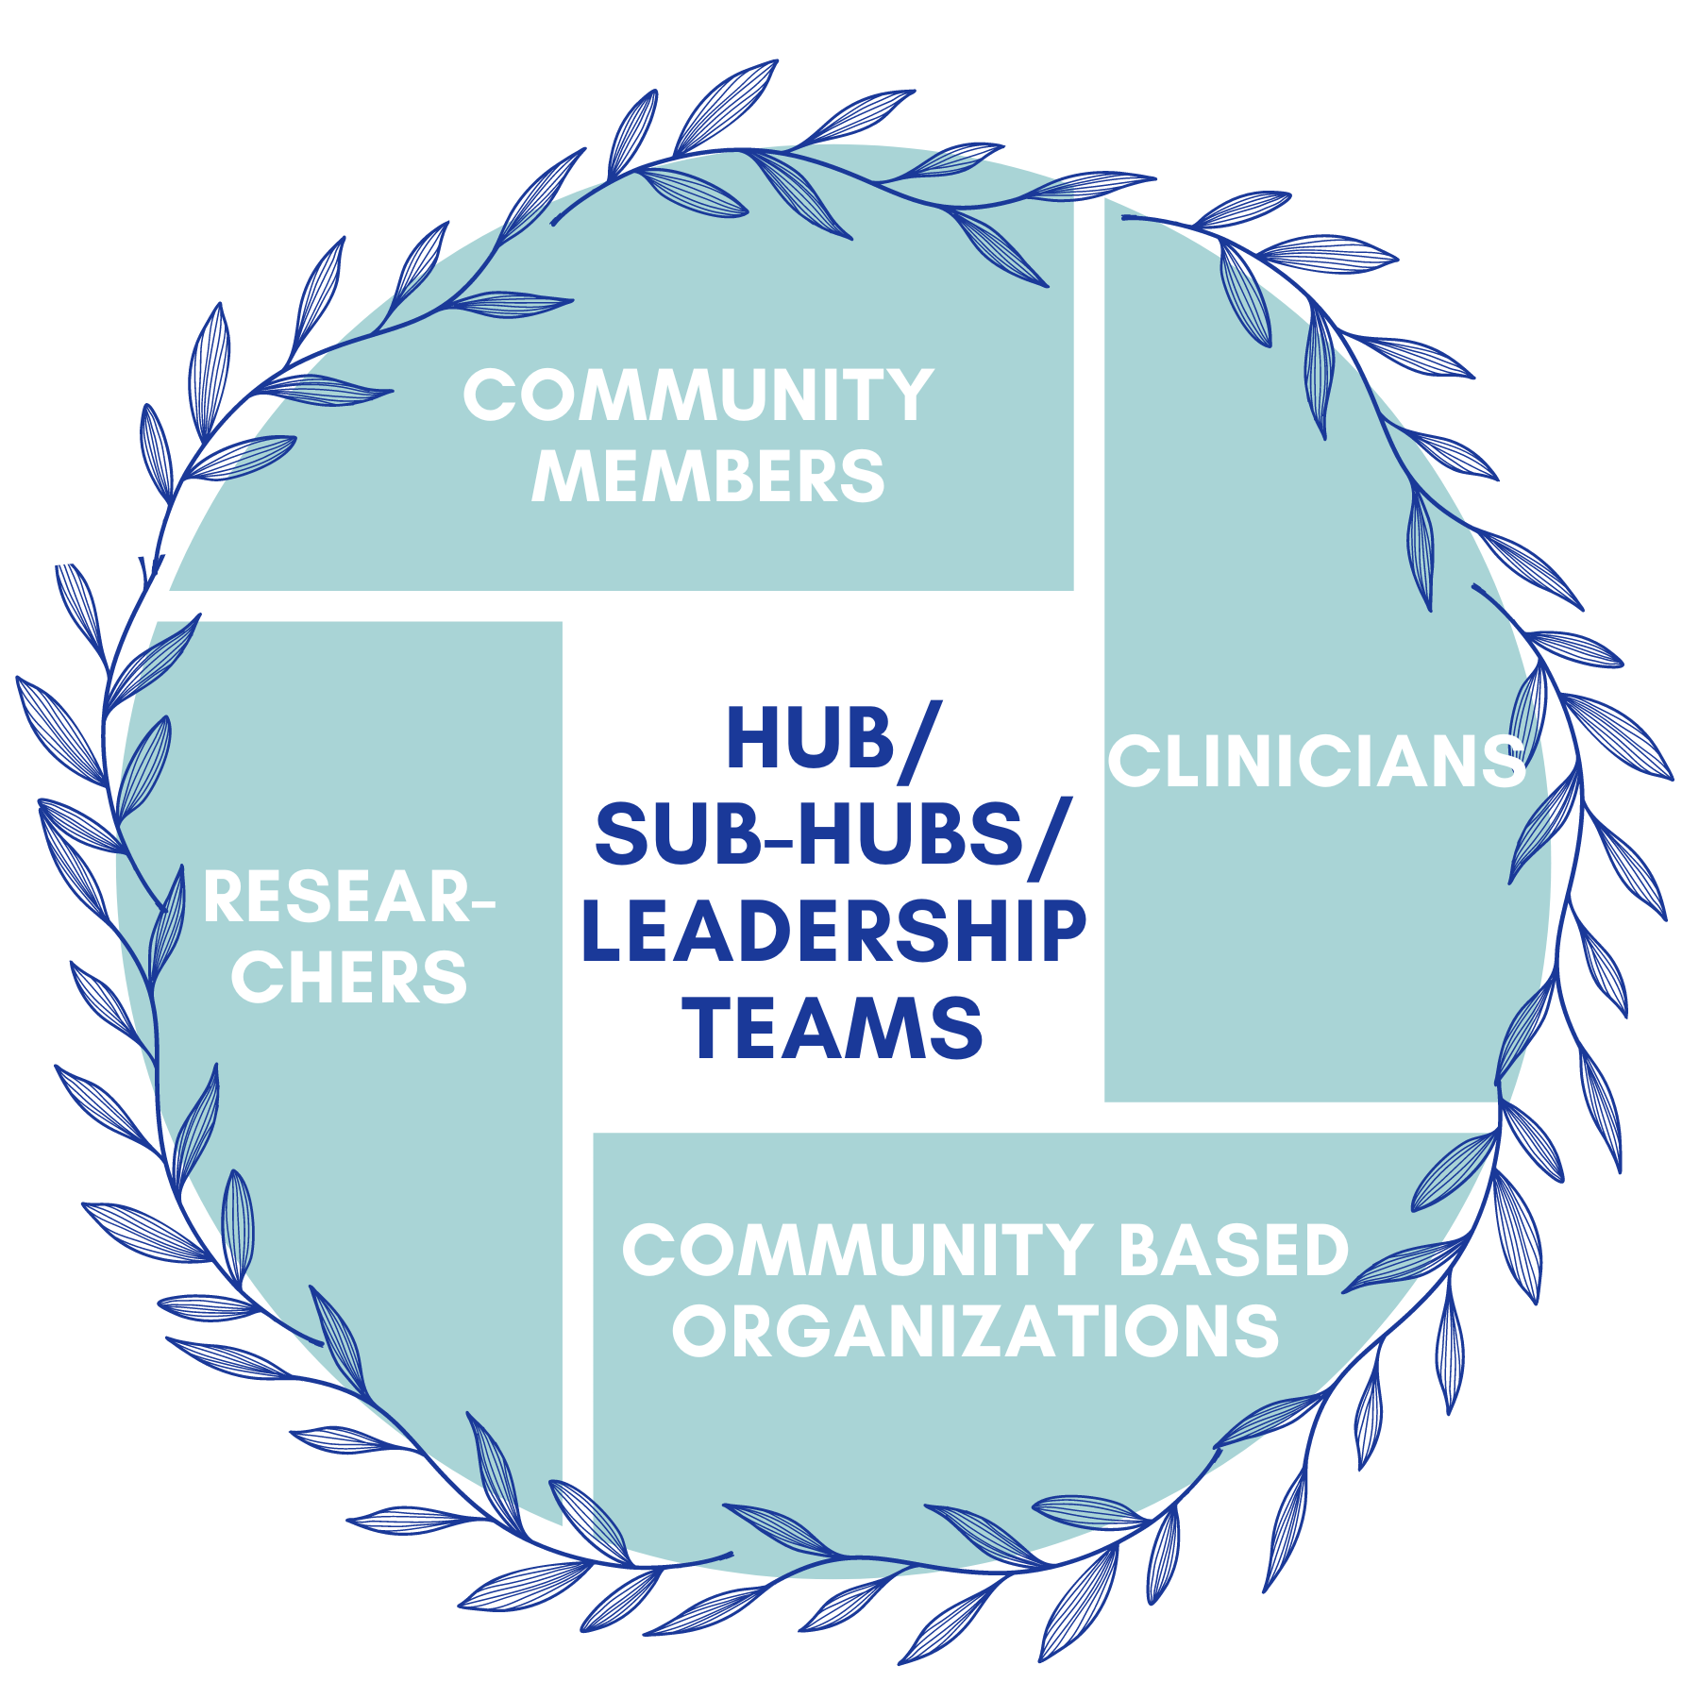
The WCHC Hub
The WCHC Hub is dedicated to creating a feminist network of people involved in the gender, HIV & STBBI movement that are interested in actively confronting misogyny, patriarchy, and historical and ongoing colonialism.
By uniting diverse stakeholders in the field of women and gender diverse people, HIV & STBBIs, our mission is to strengthen knowledge mobilization, drive system-level change, advance gender-inclusive care, and empower the full potential of all individuals involved. Our overarching goal is to enhance healthcare outcomes, eliminate gaps, and improve the quality of healthcare for women and gender diverse people with HIV & STBBIs.
logan.kennedy@wchospital.ca
www.wchchub.ca
Coming soon!

Slide 4
Overview
History of the acceptance of breast/chestfeeding in HIV
Review the updated guidelines, recommendations and science
Review details of the Canadian recommendations
Review available resources

Slide 5
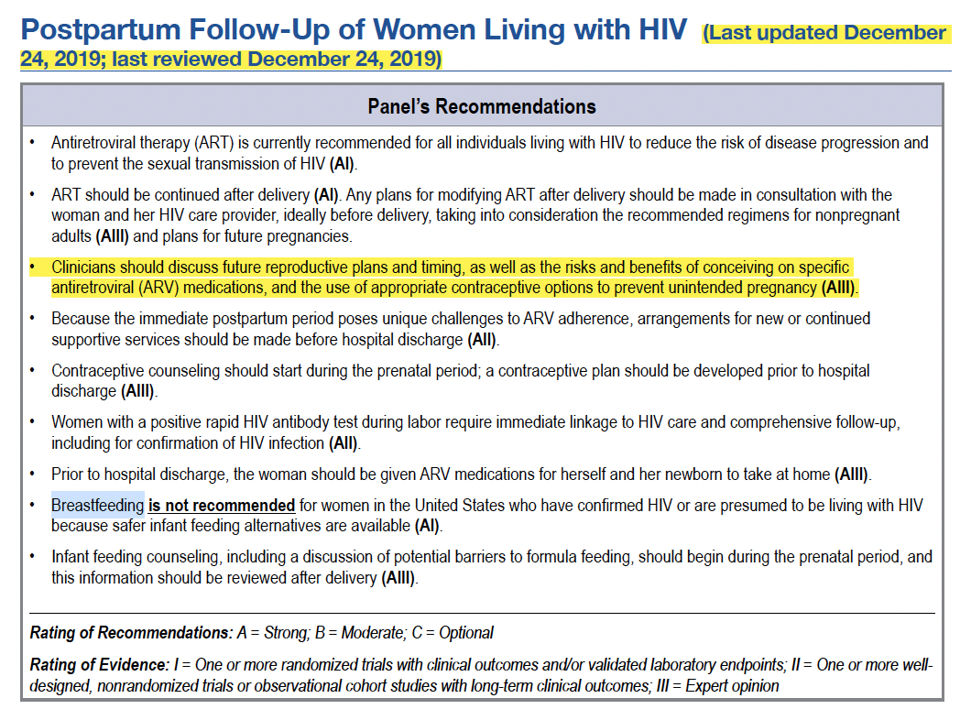
The prior US DHHS Guidelines – 2019/21 and before
Same in Canada
Breastfeeding was not recommended

Slide 6
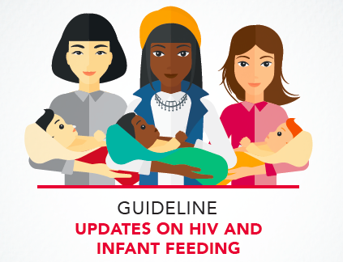
WHO HIV & Infant Guideline - 2016

Slide 7
WHO Guideline Recommendations
Recommendation 1: The Duration of Breastfeeding by Mothers living with HIV
Mothers living with HIV should breastfeed for at least 12 months and may continue breastfeeding for up to 24 months or longer (similar to the general population) while being fully supported for ART adherence (see the WHO consolidated guidelines on ARV drugs for interventions to optimize adherence).
In settings where health services provide and support lifelong ART, including adherence counselling, and promote and support breastfeeding among women living with HIV, the duration of breastfeeding should not be restricted.
WHO guidelines are mostly written for low- and mid-income countries
But technically – for the entire world

Slide 8
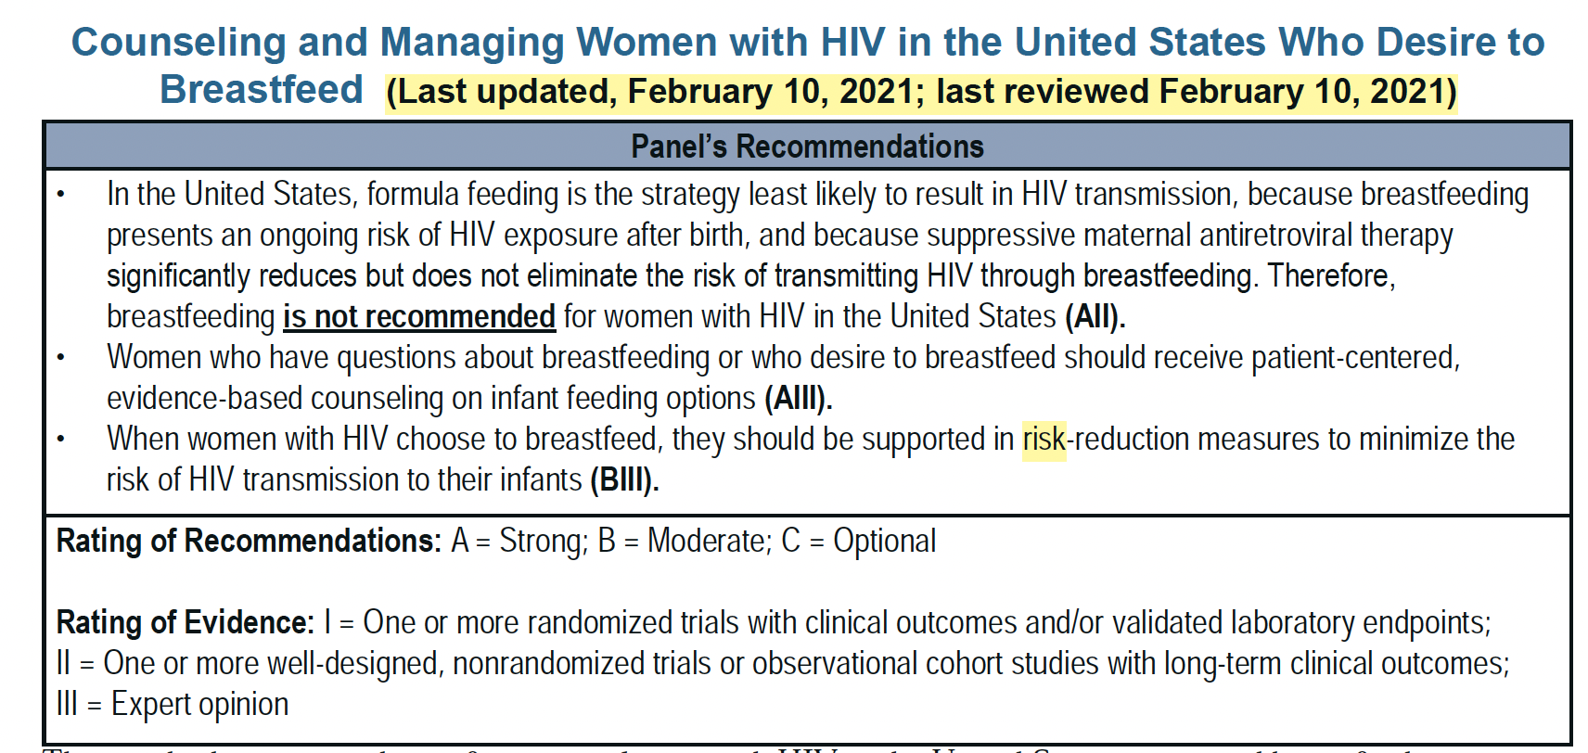
In the US – guidelines started to see some change in 2021
CONFUSING – DUE TO DISCREPENCY B/W WHO AND North American recommendations
GUIDANCE EVIDENCE UNCLEAR

Slide 9
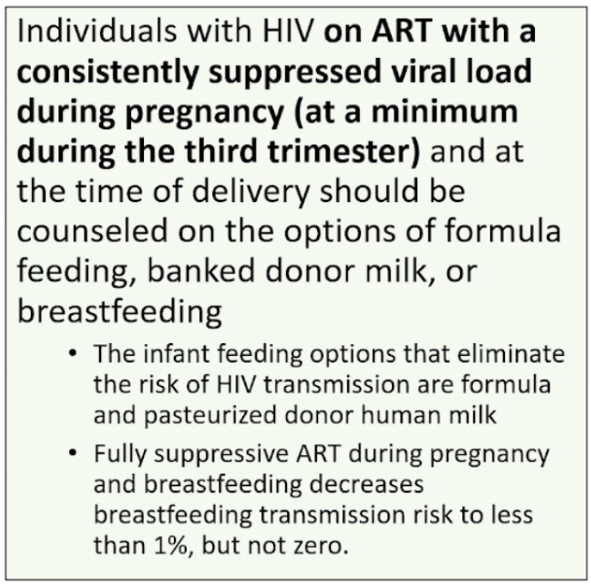
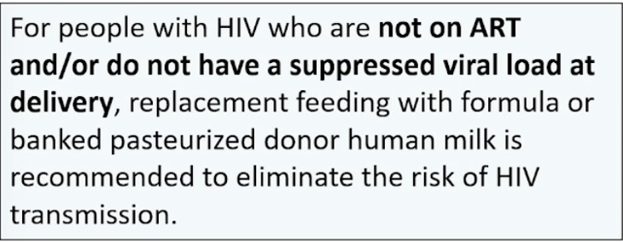
Updated DHHS Guidelines Perinatal Guideline changes on Infant Feeding – BIG CHANGE in January 31st 2023
Thank you to Dr. Judy Levison

Slide 10
Thank you to Dr. Judy Levison

Slide 11
https://jammi.utpjournals.press/doi/full/10.3138/jammi-2022-11-03

Slide 12
Eight Main Recommendations (1-4)
Exclusive formula feeding is the recommended method for feeding infants born to women living with HIV in Canada
Appropriate, trauma-informed, and culturally inclusive supports
Comprehensive unbiased counselling
Free formula should be made available for all infants born to mothers living with HIV for the first year of life
Infant formula is available in most areas of the country at no cost
Accessibility concerns
All women living with HIV should benefit from detailed multidisciplinary counseling about infant feeding well in advance of delivery by adult HIV, pediatric HIV, and prenatal care providers.
Types of infant feeding including exclusive formula (recommendation), exclusive breastfeeding, and mixed feeding
Current Global Guidelines and the science of HIV transmission through breast milk
Unknown long-term outcomes of ongoing infant exposure to maternal antiretrovirals excreted/ingested in breast milk
Interventions and advice relevant when formula feeding is planned
Interventions and advice relevant for if breastfeeding is planned
As a prerequisite to breastfeeding, healthcare providers should counsel and support women on how to optimize their health and minimize the risk of HIV transmission through breast milk

Slide 13
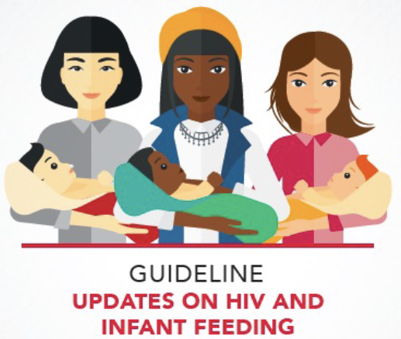
Counselling on risk of breastmilk transmission up until 2018 – best data from WHO meta-analysis
Risk derived from studies using older, less effective ART, no combination of maternal ART AND infant prophylaxis
WHO Meta-analysis
Risk of HIV transmission at 6 months estimated to be
1.08% (95% CI 0.32–1.82)
NO EVIDENCE OF VIRAL SUPPRESSION
2016
Notes:
Is a “ probably very-low” risk good enough in the context of HIV, in our setting? Or should we strive for 0 risk?

Slide 14
Most significant study estimating risk of HIV breastmilk transmission – PROMISE trial - 2018
Total N = 2392 within 6-14 days after delivery – ALL BREASTFEEDING
1220 - Maternal ART (AZT/3TC + LPV/r BID or TDF/FTC + LPV/r BID) vs.
1221 - Infant ARV (NVP)
OUTCOME – TRANSMISSION FROM BREASTFEEDING
OVERALL RESULTS - viral load response not taken into consideration OR ARM
0.3% (95% CI 0.1–0.8%) at 6 months a
0.7% (95% CI 0.3–1.4%) at 12 months
2 infants in the maternal ARV arm acquired HIV despite maternal plasma VL being non-detected (i.e., <40 copies/ml) (0.16%)

Slide 15
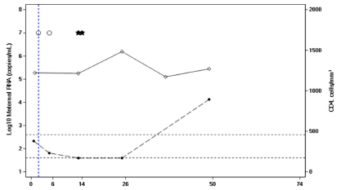
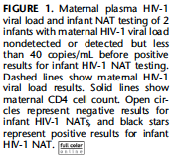
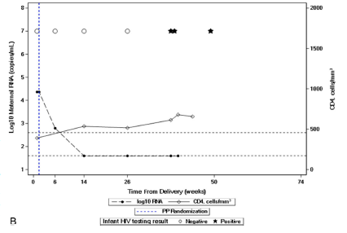
PROMISE TRIAL – 2 CASES

Slide 16
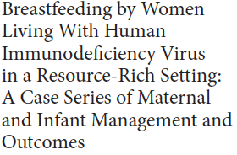
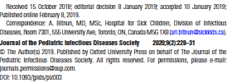
Toronto Case Series – first 3 infants breastfed in high-income countries in literature
2 women with HIV – breastfed 3 infants (1 singleton and 1 set of twins) in 2017 & 2018 in GTA supported by maternal and pediatric ID
Mother 1 – delivered at 41w – breastfed X 6 weeks; infant given AZT/3TC/NVP – no transmission
Mother 2 – delivered at 31 weeks gestation – mixed breastfed twins from week 6 – 12 weeks – infants first given AZT then given AZT/3TC/NVP X 15 weeks – no transmission

Slide 17
North American Case Series
A retrospective multi-site study was performed for individuals with HIV who breastfed from 2014-2022 in the United States (8 sites) and Canada (3 sites). Descriptive statistics were used for data analysis
72 cases reported, most had been diagnosed with HIV and were on antiretroviral therapy (ART) prior to the index pregnancy and had undetectable viral loads at delivery.
28 CASES FROM CANADA: 20 FROM TORONTO & 8 FROM MONTREAL

Slide 18
Published reports of women with HIV breastfeeding in high-income countries
Authors | Country | Year | Number of infants | Infant HIV results
Nashid et al. | Canada | 2019 | 3 | All negative
Bansaccal et al. | Belgium | 2020 | 2 | All negative
Haberl et al. | Germany | 2021 | 42 | Not reported
Yusuf et al. | USA | 2022 | 10 | All negative
Weiss et al. | Germany | 2022 | 30 – 25 optimal conditions; 5 not | All negative
Prestileo et al. | Italy | 2022 | 13 | All negative
Crizinel | Switzerland | Feb 2023 | 25 | 24 neg; 1 pending
Levinson et al. | USA + Canada | April 2023 | 72 (including 3 above) – not all suppressed | 68 negative; 4 LFU
Francis et al. | UK | April 2023 | 267; 150 with infant HIV results | 111 neg; 34 pending; 5 LFU
TOTAL w/ reported infant HIV PCR | Global | As of April 2023 | 302 | 258 neg; 35 pending; 9 LFU

Slide 19
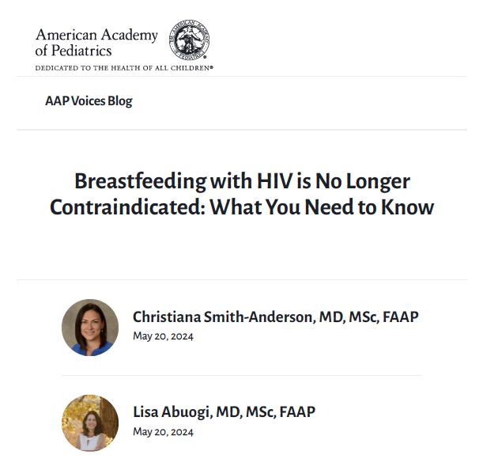
American Pediatric Association

Slide 20
International Group – Community members, Clinicians & Researchers - https://www.wlhiv.org/informplus
Notes:
The purpose of the International Feeding Choices Forum for People Living with HIV (INFORM+) is to foster collaboration, knowledge exchange, and research initiatives among forum members from different countries. The working group aims to address critical challenges in providing accurate and balanced feeding choice advice to people living with HIV, advance medical research in this area, and promote evidence-based clinical practice amongst providers.

Slide 21
Main Recommendations (5: Maternal recommendations)
Back to Canadian Guidelines
If a person with HIV chooses to breast/chestfeed
For women meeting criteria to breastfeed (adherent to treatment), monthly maternal monitoring (including viral load testing), and follow up is recommended until cessation of breastfeeding to ensure ongoing support.
Maintaining adherence and virologic suppression
Maintaining optimal breast health
Total duration of breastfeeding should be minimized
Weaning from breast to bottle feeding can be done by a willing mom and an accepting infant over a period of less than two weeks

Slide 22
Main Recommendations (6: Infant recommendations)
For infants being breastfed, a comprehensive management strategy is recommended.
ARV prophylaxis is recommended for infants who are being breastfed
Breastfed infants should remain on antiretroviral prophylaxis until 1 month after complete cessation of breastfeeding while monitoring for toxicity.
​​HIV PCR testing of infant (birth, 2 weeks, 4 weeks, then every 1 to 2 months until 2 months after last breastmilk exposure)
Ongoing neurodevelopmental follow-up
Monitoring infant’s oral and gut health

Slide 23
Main Recommendations (6: Infant recommendations)

Slide 24
Main Recommendations (6: Infant recommendations)

Slide 25
Main Recommendations: (7 reporting and 8 monitoring)
7. Service providers should not report a person living with HIV to child protection services or police for breastfeeding.
8. A robust surveillance system should be in place to monitor for cases of breastmilk transmission of HIV in order to further knowledge and detect gaps in care.

Slide 26
AVAILABLE RESOURCES
For the community and for the providers to address these important issues raised by the community
CATIE – Feeding your baby
CATIE – Video & blog
WHAI HIV Mothering Toolkit
OHTN – coming out with resources SOON

Slide 27
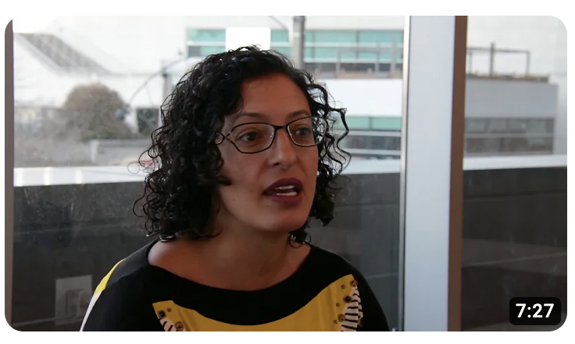
CATIE VIDEO
https://www.youtube.com/
watch?v=31e_P_jy5GY&ab_channel=CATIE

Slide 28
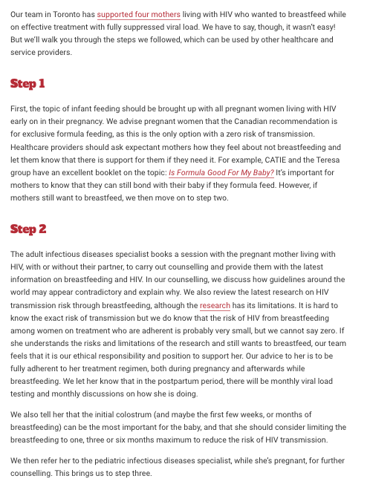
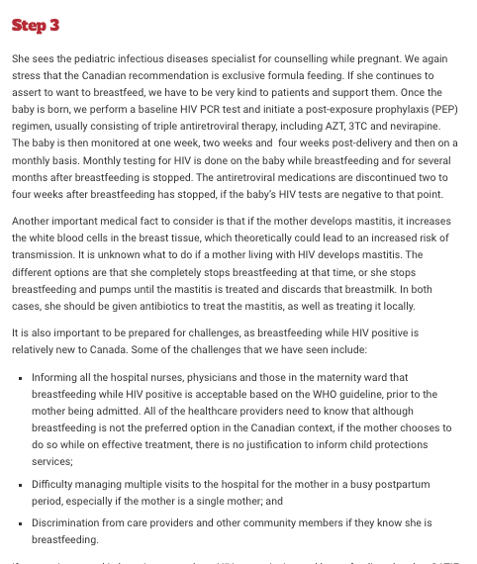
https://blog.catie.ca/2019/03/11/a-step-by-step-process-on-how-we-can-support-mothers-living-with-hiv/

Slide 29
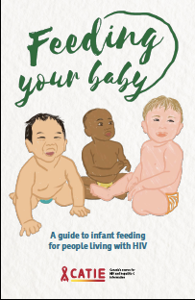
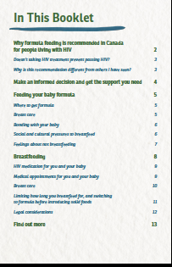
https://www.catie.ca/feeding-your-baby

Slide 30
Questions?

